Slide 1

Programming and problem solving with python
Chapter 9
List Processing :Searching and Sorting
Copyright © 2018 McGraw Hill Education, All Rights Reserved.
PROPRIETARY MATERIAL © 2018 The McGraw Hill Education, Inc. All rights reserved. No part of this PowerPoint slide may be displayed, reproduced or distributed in any form or by any means, without the prior written permission of the publisher, or used beyond the limited distribution to teachers and educators permitted by McGraw Hill for their individual course preparation. If you are a student using this PowerPoint slide, you are using it without permission.

Slide 2
Introduction to Searching Techniques
Searching is a technique of finding an element from a given list of elements.
The searching techniques should be able to locate the element to be searched as quickly as possible.
The search techniques are categorized as follows.
Linear or Sequential Search
Binary Search

Slide 3
Linear/Sequential Search
In Linear Search elements are examined sequentially starting from the first element.
It compares the element to be searched i.e. the (Key element) sequentially with each element in the list.
The process of searching terminates when the element to be searched is found within the list .
The Process of searching the element to be searched may be exhausted if the element to be searched is not found within the list.

Slide 4
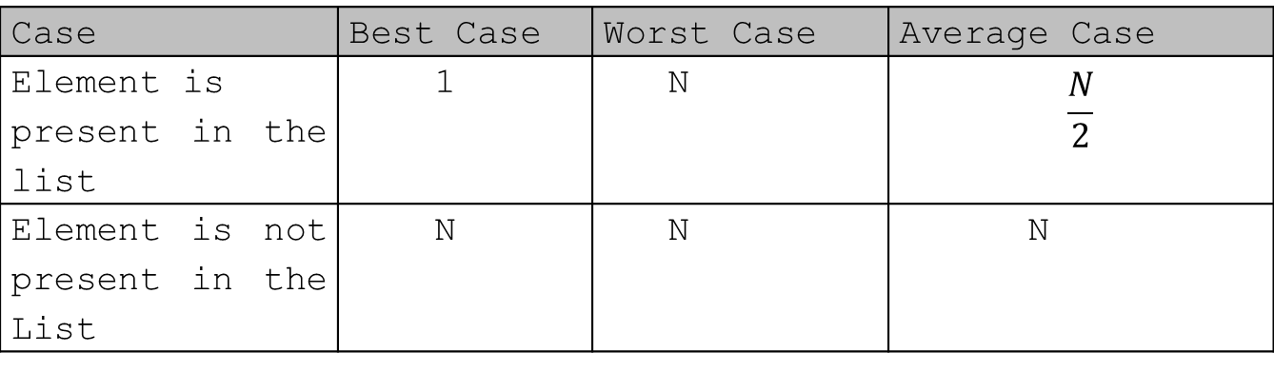
Unordered List – Analysis of Sequential Search
Case | Best Case | Worst Case | Average Case
Element is present in the list | 1 | N | $$\frac{N}{2}$$
Element is not present in the List | N | N | N

Slide 5
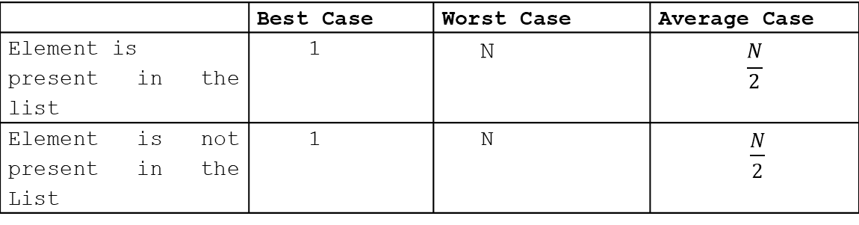
Sorted List – Analysis of Sequential Search
Expected number of comparisons required for unsuccessful search can be reduced if the list is sorted.
Example:
List1[] = 10 15 20 25 50 60 70 80
Element to be searched = 30
Search should terminate here
 | Best Case | Worst Case | Average Case
Element is present in the list | 1 | N | $$\frac{N}{2}$$
Element is not present in the List | 1 | N | $\frac{N}{2}$

Slide 6
The Binary Search
Need of Binary Search ?
Let us consider the size of List is 1 Million (2²⁰).
Thus, if we want to search using sequential search algorithm then in the worst case we require 2²⁰ comparisons.
It means sequential search algorithm is not good for list with large size.
Thus we require more efficient algorithms and binary search algorithm is one of the simple and efficient algorithm.

Slide 7
Binary Search…….
To implement binary search algorithm the element within the list must be in sorted order i.e. in ascending order.
The binary search algorithm is based on the following three conditions.
If the key is less than the list’s middle element, then the programmer has to search only in the first half of the list.
If the key is greater than the list’s middle element, then the programmer has to search only in the second half of the list.
If the element to be found i.e. the key element is equal to lists middle element then search ends.
If the element to be found is not present within the list then the it returns None or -1 which it indicates the element to be searched is not present in the list.

Slide 8
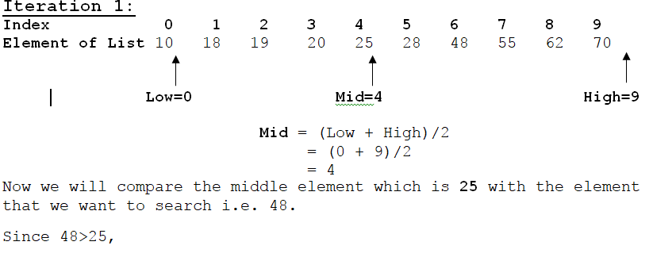
Consider the sorted List of 10 integers.
10 18 19 20 25 28 48 55 62 70
Element to be searched = 48

Slide 9
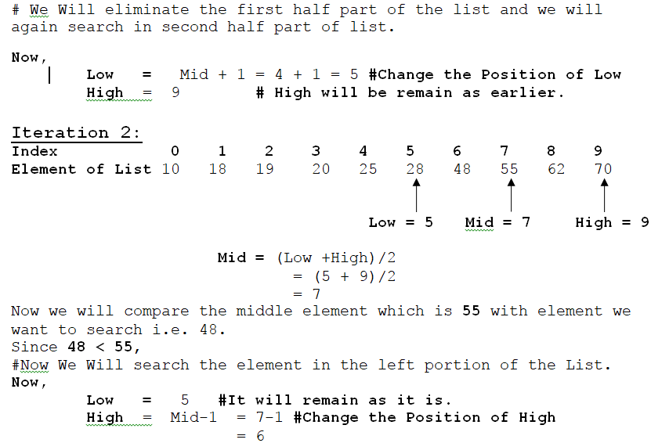

Slide 10
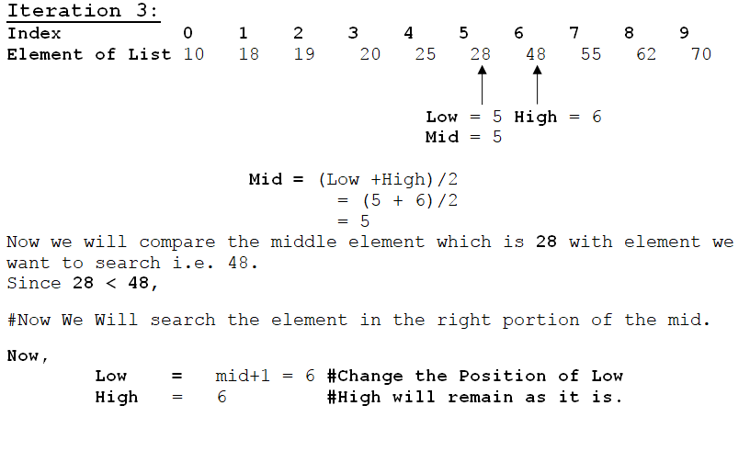

Slide 11
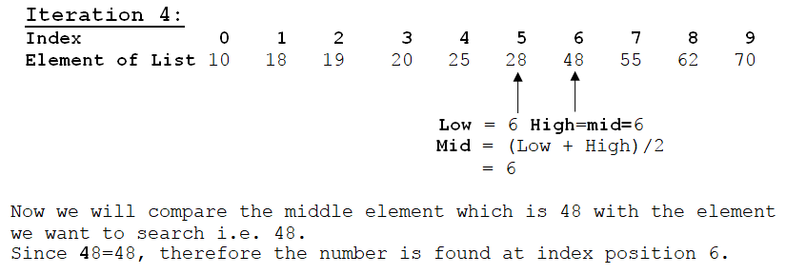

Slide 12
Introduction to Sorting Techniques
Sorting means rearranging the elements of a list, so that they are kept in some relevant order.
The order can be either ascending or descending. Consider list L1, if the elements within the list are arranged in ascending order in such a way that L1[0] < L1[1] < …………<L[N].
Sorting algorithms are broadly classified into two types
a) Internal sorting - main memory
b) External Sorting - Secondary memory
Various sorting algorithms are as follows
a) Bubble sort,
b) Selection sort
c) Insertion sort
d) Quick Sort
e) Merge Sort

Slide 13
Bubble Sort
Bubble sort, sorts the list elements by repeatedly moving the largest element to the highest index position of the list.
The consecutive adjacent pair of elements in lists is compared with each other.
If the element at lower index is greater than the element at the higher index, then the two elements are interchanged so that element with smaller value is placed before the bigger one.
The algorithm repeats this process till the list of unsorted element exhausts.

Slide 14
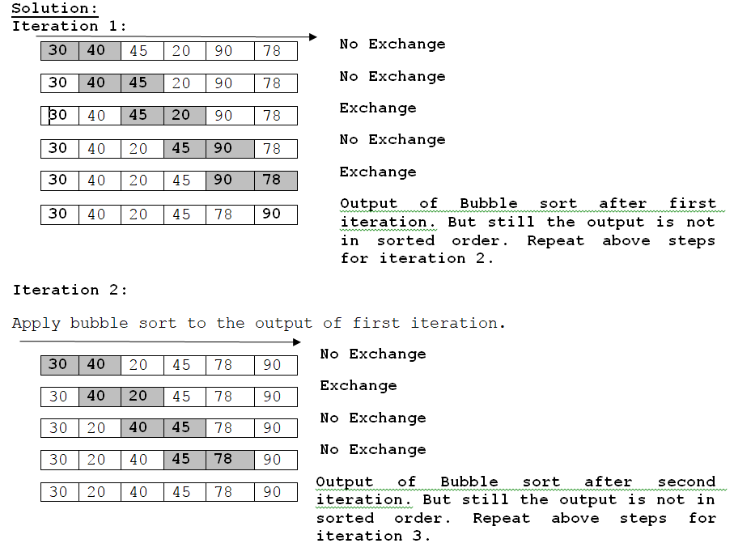
Example of Bubble sort:
Consider elements within the list as follows
L1 = [30, 50, 45, 20, 90, 78]
Sort the list using Bubble sort.

Slide 15
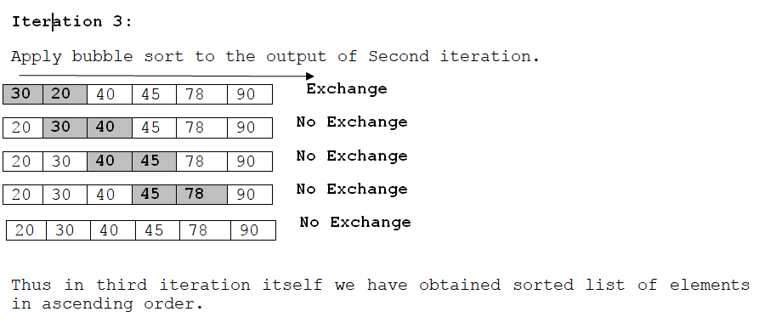

Slide 16
Selection Sort
The whole process of selection sort will be as follows
Iteration 1:
Search the smallest element from list[0] to list[N-1].
Interchange list[0] with smallest element.
Result: list[0] is sorted.
Iteration 2:
Search the smallest element from list[1] to list[N-1].
Interchange list[1] with smallest element.
Result: list[0],list[1] is sorted.
Iteration N-1:
Search the smallest element from list[N-1] to list[N-1].
Interchange list[N-1] with smallest element.
Result: list[0]…………list[N-1].

Slide 17
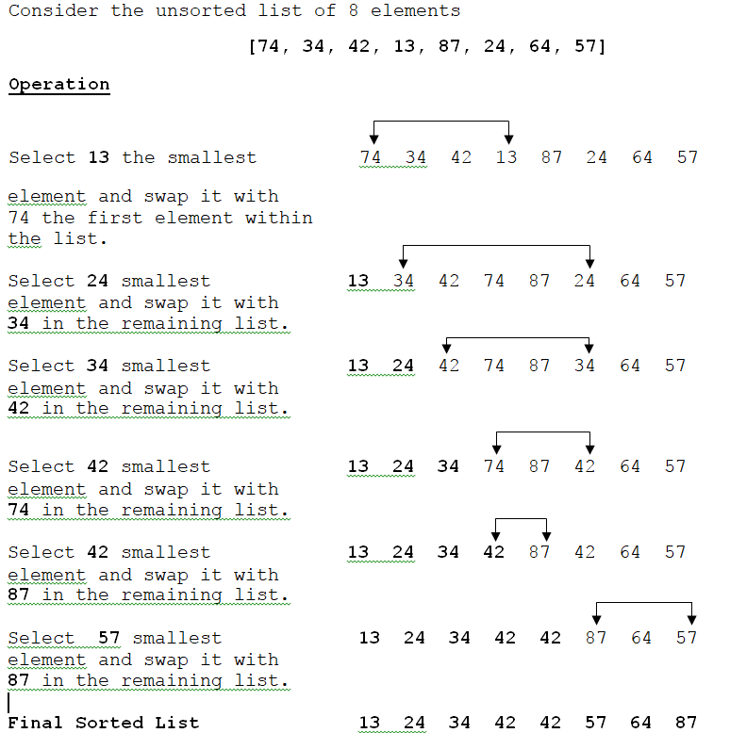

Slide 18
Insertion Sort
Insertion sort is based on the principle of inserting the elements at its correct place in a previously sorted list.
It always maintains a sorted sublist in the lower portion of the list.
Each new element is inserted back into the previous sub list.

Slide 19
Quick Sort
Quick sort in one of the fastest internal sorting algorithms. The quick sort algorithm is based on three main strategies.
Split or Partition: Select a random element called pivot from the sequence of elements to be sorted. Suppose the selected element is X where X is any number. Now split (Divide) the list into the two small lists Y and Z such that
All the elements of the first part Y are less than the selected element pivot.
All the elements of the second part Z are greater than the selected element Pivot.
Sort the Sub arrays.
Merge (Join/Concatenate) the sorted sub array.

Slide 20
Merge Sort
The merge sort is based on three main strategies.
Split the List into two Sub List (Split or Divide): Split means partitioning the n elements of list into two sub lists. Where each sub list contains n/2 elements each.
Sort Sub Lists (Conquer): Sorting two sub arrays recursively using merge sort.
Merge the sorted sub lists (Combine): Combine means merging two sorted sub lists each of size n/2 to produce the sorted list of n elements.

Slide 21
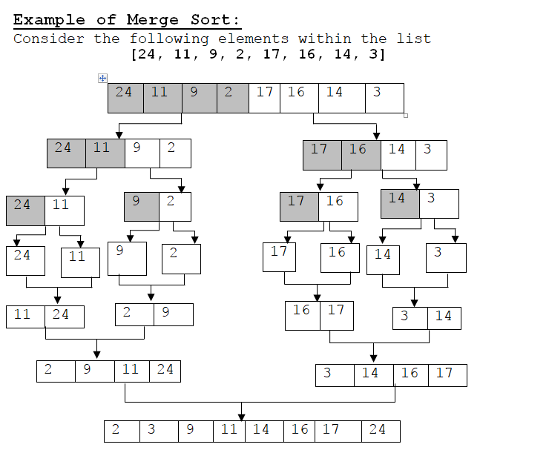
Example: Merge Sort

Slide 22
Conclusion
Linear search, searches element sequentially from the list till the element is found.
Binary search is most efficient algorithm which reduces no of comparisons to search the element.
Various sorting algorithms such as bubble sort, selection sort, quick sort and merge sort have been covered.

